Slide 1
C2P India
OPF Business Service Pattern

Slide 2
Agenda
Activities (Week 1):
Onboard Stakeholders (Operations, Core Team)
Accumulate existing training material for each discipline (BA, Dev/TA, DM, QA)
Derive Servers & Trainee Workstation configuration with recommended S/W
Assessments Criteria (Practical, Hand-On based)
Approaches discussed:
Managing Assessments
Impart Trainings
Digital Media creation
OPF Business Service Pattern Overview
OPF Business Service Pattern Guidelines
EJB remote interface guidelines
EJB Bean guidelines
Service POJO guidelines
Service config guidelines
Service POJO implementation guidelines
Service Provider Interface (SPI) guidelines
References

Slide 3
Introduction to OPF Business Service Pattern
Activities (Week 1):
Onboard Stakeholders (Operations, Core Team)
Accumulate existing training material for each discipline (BA, Dev/TA, DM, QA)
Derive Servers & Trainee Workstation configuration with recommended S/W
Assessments Criteria (Practical, Hand-On based)
Approaches discussed:
Managing Assessments
Impart Trainings
Digital Media creation
OPF Business Service pattern comes into picture when a new EJB service is to be implemented
The pattern is a set of guidelines including naming convention as well as design recommendations
Objective of the pattern is to development configurable, extendable services

Slide 4
EJB remote interface guidelines
Activities (Week 1):
Onboard Stakeholders (Operations, Core Team)
Accumulate existing training material for each discipline (BA, Dev/TA, DM, QA)
Derive Servers & Trainee Workstation configuration with recommended S/W
Assessments Criteria (Practical, Hand-On based)
Approaches discussed:
Managing Assessments
Impart Trainings
Digital Media creation
The remote interface should end with “Service”
The methods should return a GenericIssueLog
An entityKey (Long), className (String) and flowContext (FlowContext) are to be provided as parameters.
Additional parameters may be passed as well if needed
For methods that operate on payment entities, the name of the payment entity should be included in the method name. So instead of just having a method called reject(…) the method should be called rejectTransactions(…) if it operates on transactions, rejectInstructions(…) if it operates on instructions etc… Note that combinations are allowed, for example in some service you could find method names like checkInstructionsAndTransactions(…) indicating that this method operates on both instructions as transactions.

Slide 5
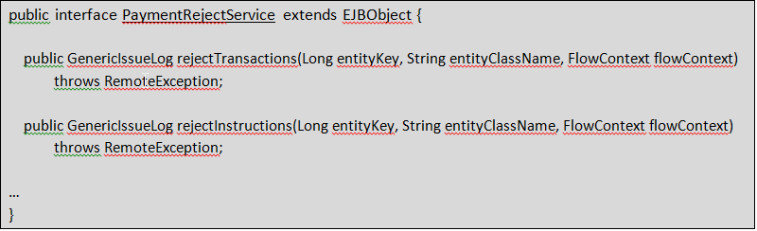
EJB remote interface guidelines (2)
Activities (Week 1):
Onboard Stakeholders (Operations, Core Team)
Accumulate existing training material for each discipline (BA, Dev/TA, DM, QA)
Derive Servers & Trainee Workstation configuration with recommended S/W
Assessments Criteria (Practical, Hand-On based)
Approaches discussed:
Managing Assessments
Impart Trainings
Digital Media creation

Slide 6
EJB Bean guidelines
Activities (Week 1):
Onboard Stakeholders (Operations, Core Team)
Accumulate existing training material for each discipline (BA, Dev/TA, DM, QA)
Derive Servers & Trainee Workstation configuration with recommended S/W
Assessments Criteria (Practical, Hand-On based)
Approaches discussed:
Managing Assessments
Impart Trainings
Digital Media creation
The class name ends with “ServiceBean”.
A typed instance field is used to keep a reference to the POJO implementation.
The POJO implementation is loaded by making a call to the ServiceBeanHelper class inside the setSessionContext() method. ServiceBeanHelper has the following behavior:
It loads the value for the property “config-file” from the java:comp/env context.
It loads the value for the property “service-id” from the java:comp/env context.
It uses the ConfigurationFactory to load a configurable object
It wraps in inside a dynamic proxy for auto-management of the Flow Context (see approach document for Flow Context and Agreement-aware flows)
The business method takes care of converting payment parameters to Long and Class.
The business method registers the new FlowContext within the OPF Framework
The POJO implementation is called

Slide 7
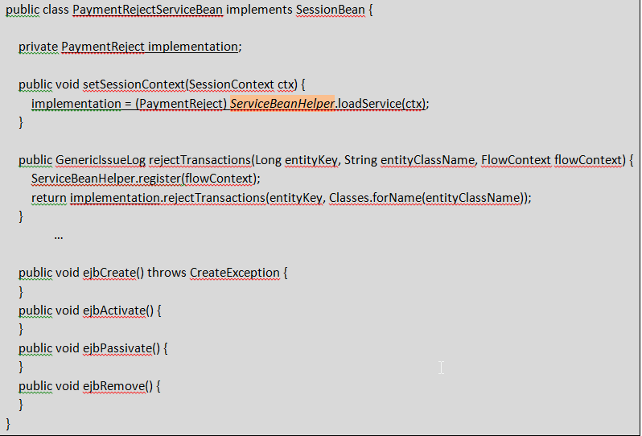
EJB Bean guidelines (2)
Activities (Week 1):
Onboard Stakeholders (Operations, Core Team)
Accumulate existing training material for each discipline (BA, Dev/TA, DM, QA)
Derive Servers & Trainee Workstation configuration with recommended S/W
Assessments Criteria (Practical, Hand-On based)
Approaches discussed:
Managing Assessments
Impart Trainings
Digital Media creation

Slide 8
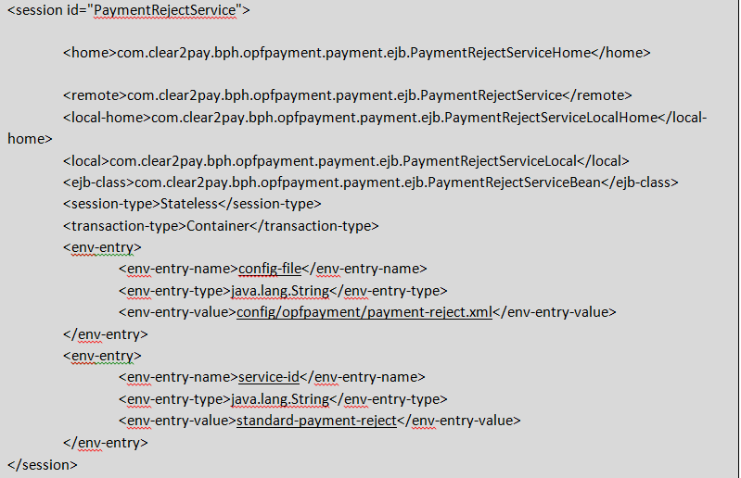
EJB Bean guidelines (3)
Activities (Week 1):
Onboard Stakeholders (Operations, Core Team)
Accumulate existing training material for each discipline (BA, Dev/TA, DM, QA)
Derive Servers & Trainee Workstation configuration with recommended S/W
Assessments Criteria (Practical, Hand-On based)
Approaches discussed:
Managing Assessments
Impart Trainings
Digital Media creation

Slide 9
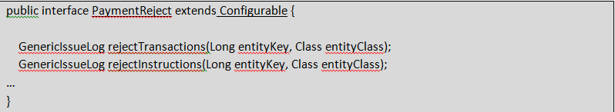
Service POJO guidelines
Activities (Week 1):
Onboard Stakeholders (Operations, Core Team)
Accumulate existing training material for each discipline (BA, Dev/TA, DM, QA)
Derive Servers & Trainee Workstation configuration with recommended S/W
Assessments Criteria (Practical, Hand-On based)
Approaches discussed:
Managing Assessments
Impart Trainings
Digital Media creation
The interface does not contain the word “Service”.
It extends Configurable (it may extend additional interfaces as well) .
It uses a Long and a Class as parameter.

Slide 10
Service config guidelines
Activities (Week 1):
Onboard Stakeholders (Operations, Core Team)
Accumulate existing training material for each discipline (BA, Dev/TA, DM, QA)
Derive Servers & Trainee Workstation configuration with recommended S/W
Assessments Criteria (Practical, Hand-On based)
Approaches discussed:
Managing Assessments
Impart Trainings
Digital Media creation
The root tag is a dashed lowercase version of the POJI name, with config as suffix.
For example, for the Duplicate Check Service configuration file, the root tag should be:
<duplicate-check-config>
The POJO is listed inside a “/service@id/classname” path. This is mandatory for the ServiceBeanHelper to behave correctly and be able to load the service implementation transparently from java:comp/env.
The classname of the POJO implementation must have a meaningful name.
For example, BatchPaymentReject or IndividualPaymentReject.
The following names are to be avoided:
BasePaymentReject, RiskPaymentReject, SimplePaymentReject, DefaultPaymentReject
If no good name can be found, the use of the prefix “Standard” is recommended.
The “service-id” value that appears in /service@id must reflect the purpose of the class. If the class has been correctly name, the classname can be reused in dashed lowercase.
For example, batch-payment-reject or individual-payment-reject
Avoid:
default, payment-reject
The configuration node following the classname declaration must reflect the purpose of the class. If no good-name can be found, a dashed lowercase version of the classname can be used, i.e.
<standard-payment-reject id=”config”>
This node must contain an “id” attribute so that it can be overridden by other implementations. The recommended id attribute for this type of nodes is “config”.

Slide 11
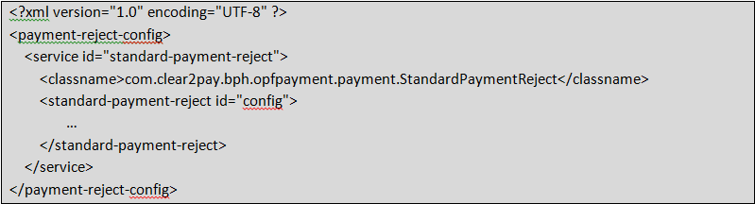
Service config guidelines (2)
Activities (Week 1):
Onboard Stakeholders (Operations, Core Team)
Accumulate existing training material for each discipline (BA, Dev/TA, DM, QA)
Derive Servers & Trainee Workstation configuration with recommended S/W
Assessments Criteria (Practical, Hand-On based)
Approaches discussed:
Managing Assessments
Impart Trainings
Digital Media creation

Slide 12
Service POJO implementation guidelines
Activities (Week 1):
Onboard Stakeholders (Operations, Core Team)
Accumulate existing training material for each discipline (BA, Dev/TA, DM, QA)
Derive Servers & Trainee Workstation configuration with recommended S/W
Assessments Criteria (Practical, Hand-On based)
Approaches discussed:
Managing Assessments
Impart Trainings
Digital Media creation
A dedicated sub-configuration object is being instantiated. It contains all the configuration details of the current POJO.
The new method loadConfigurable is being used to load SPI implementation. There is no need to call various methods in-line and add a “.” at the end of the configuration path prefix. This replaces calls to
ConfigurationFactory.getInstance().createConfigurable(subconfig, “r-interchange-handler.”);
Calls to business methods defined in the POJI interface are immediately delegated to a PaymentTransactionVisitor implementation.
The PaymentTransactionVisitor class takes care of navigating the payment tree. This allows a StopPayment implementation that is focused on transactions to be used transparently in transaction flows, opic flows, instruction flows and interchange flows. See Appendice A for more details.
PaymentTransactionVisitor is abstract and requires subclasses to define their own implementation of “visitTransaction”. This method is applied to every transaction in the flow.
One PaymentTransactionVisitor must be implemented per business method in the POJI interface.
GenericIssue message should preferably contain the display id of the transaction instead of its primary key.

Slide 13
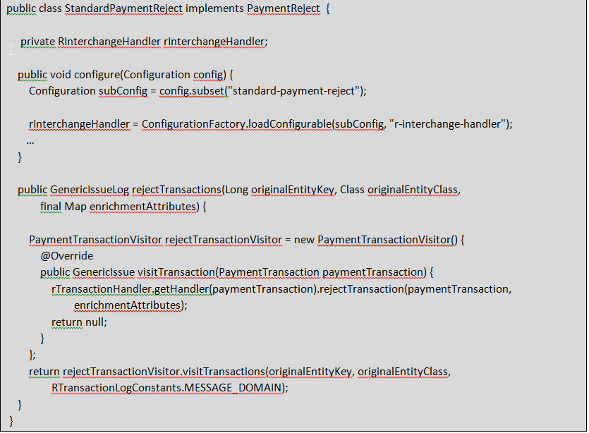
Service POJO implementation guidelines(2)
Activities (Week 1):
Onboard Stakeholders (Operations, Core Team)
Accumulate existing training material for each discipline (BA, Dev/TA, DM, QA)
Derive Servers & Trainee Workstation configuration with recommended S/W
Assessments Criteria (Practical, Hand-On based)
Approaches discussed:
Managing Assessments
Impart Trainings
Digital Media creation

Slide 14
Service Provider Interface (SPI) guidelines
Activities (Week 1):
Onboard Stakeholders (Operations, Core Team)
Accumulate existing training material for each discipline (BA, Dev/TA, DM, QA)
Derive Servers & Trainee Workstation configuration with recommended S/W
Assessments Criteria (Practical, Hand-On based)
Approaches discussed:
Managing Assessments
Impart Trainings
Digital Media creation
The SPI must be an interface. The use of abstract classes to define contracts is heavily discouraged.
The interface must extend Configurable as it is loaded through the Configuration framework and will be injected with a subconfig object upon successful instantiation.
The StandardPaymentReject’s configure method does not make use of the AbstractFactory or any other pattern framework. It uses the subconfig object and the loadConfigurable method directly.

Slide 15
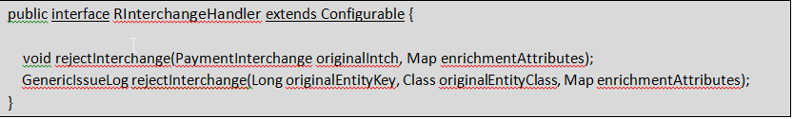
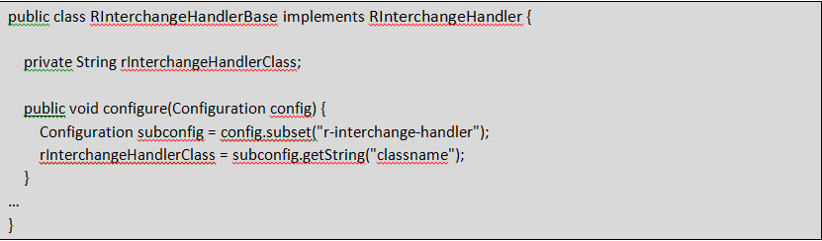
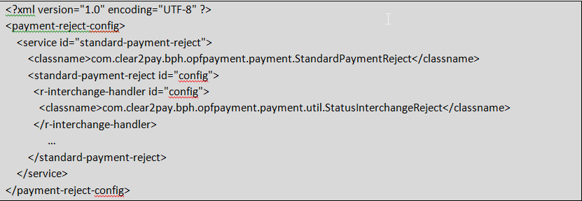
Service Provider Interface (SPI) guidelines(2)
Activities (Week 1):
Onboard Stakeholders (Operations, Core Team)
Accumulate existing training material for each discipline (BA, Dev/TA, DM, QA)
Derive Servers & Trainee Workstation configuration with recommended S/W
Assessments Criteria (Practical, Hand-On based)
Approaches discussed:
Managing Assessments
Impart Trainings
Digital Media creation

Slide 16
Service Provider Interface (SPI) guidelines(3)
Activities (Week 1):
Onboard Stakeholders (Operations, Core Team)
Accumulate existing training material for each discipline (BA, Dev/TA, DM, QA)
Derive Servers & Trainee Workstation configuration with recommended S/W
Assessments Criteria (Practical, Hand-On based)
Approaches discussed:
Managing Assessments
Impart Trainings
Digital Media creation
The name of the tag that defines the SPI element is a dashed lowercase version of the SPI interface name.
The classname of the SPI implementation must have a meaningful name.
The “id” value that appears in SPI must be the same as the tag name.
The configuration node following the classname declaration must reflect the purpose of the class. If no good name can be found, a dashed lowercase version of the classname can be used, i.e.
< r-interchange-handler id=”config”>
This node must contain an “id” attribute so that it can be overridden by other implementations. The recommended id attribute for this type of nodes is “config”.

Slide 17
References
Activities (Week 1):
Onboard Stakeholders (Operations, Core Team)
Accumulate existing training material for each discipline (BA, Dev/TA, DM, QA)
Derive Servers & Trainee Workstation configuration with recommended S/W
Assessments Criteria (Practical, Hand-On based)
Approaches discussed:
Managing Assessments
Impart Trainings
Digital Media creation
https://svn-mec.clear2pay.com/svn/repos/rd/core/OPF/trunk/doc/Technical/working%20documents/technical%20notes/Approach%20-%20Business%20Service%20Pattern.docx

Slide 18
EMEA – Headquarters
Brussels, Belgium
info@clear2pay.com
APAC
Sydney, Australia
info.apac@clear2pay.com
Americas
Atlanta, USA
info.americas@clear2pay.com
www.clear2pay.com

